Slide 1
Employee Data Analysis using Excel
STUDENT NAME: SANJEEVI A
REGISTER NO: 312213177
DEPARTMENT: B.COM (ACCOUNTING & FINANCE)
COLLEGE: TAGORE COLLEGE ARTS AND SCIENCE

Slide 2
PROJECT TITLE
Employee Performance Analysis
using Excel

Slide 3

AGENDA
Problem Statement
Project Overview
End Users
Our Solution and Proposition
Dataset Description
Modelling Approach
Results and Discussion
Conclusion

Slide 4
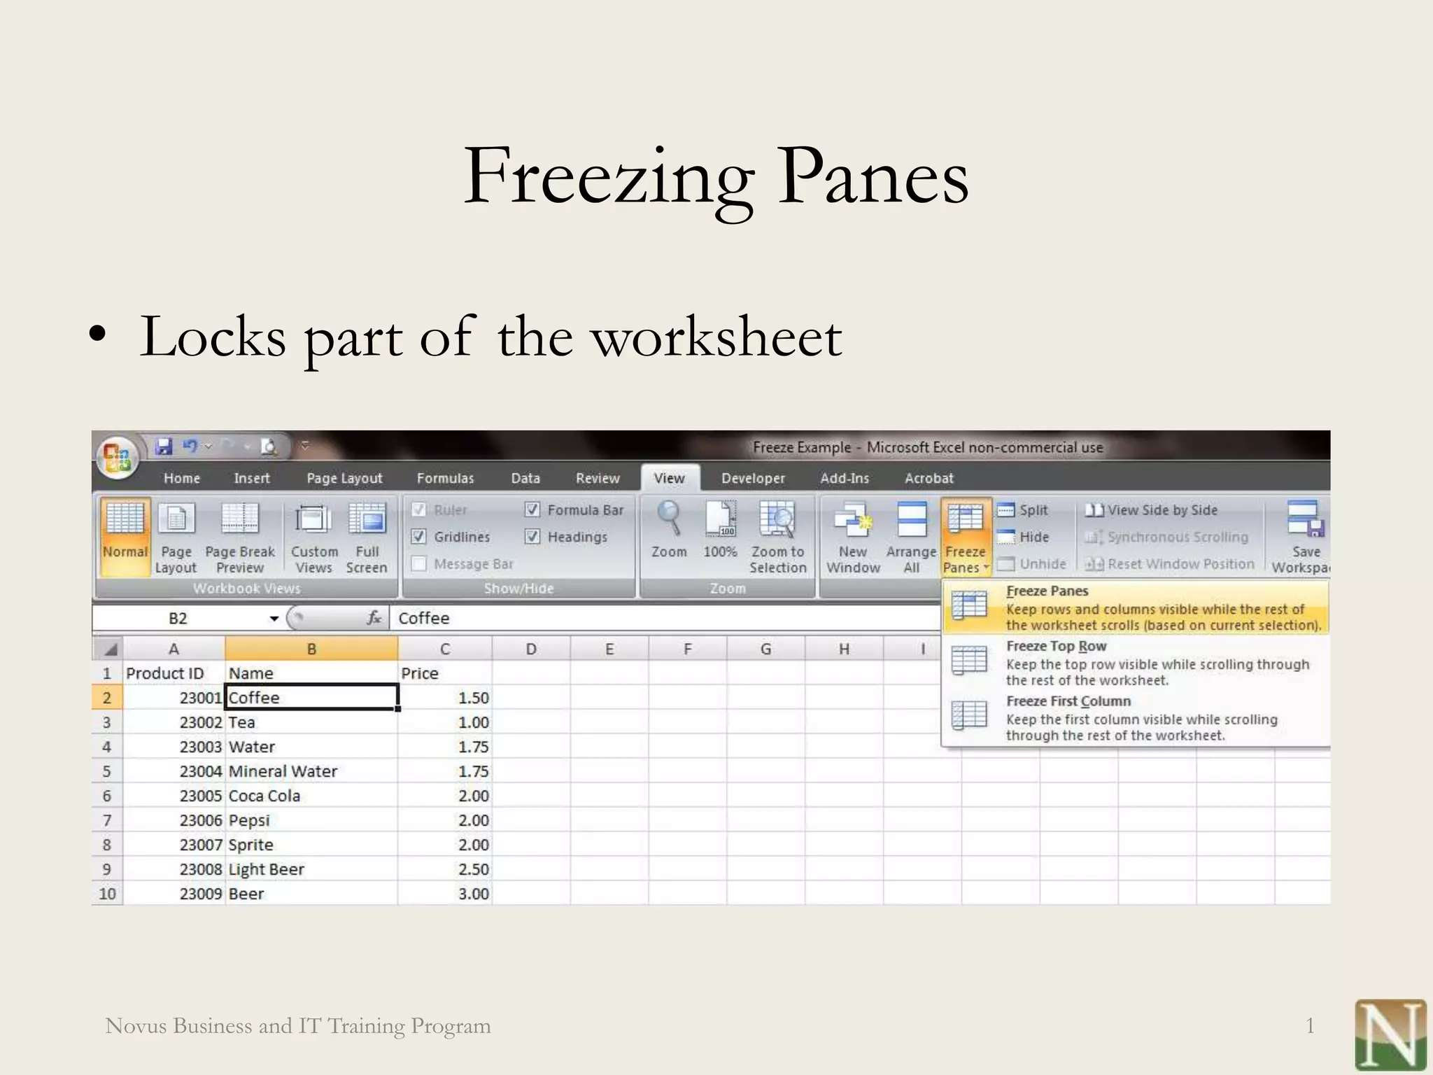
PROBLEM STATEMENT

Slide 5
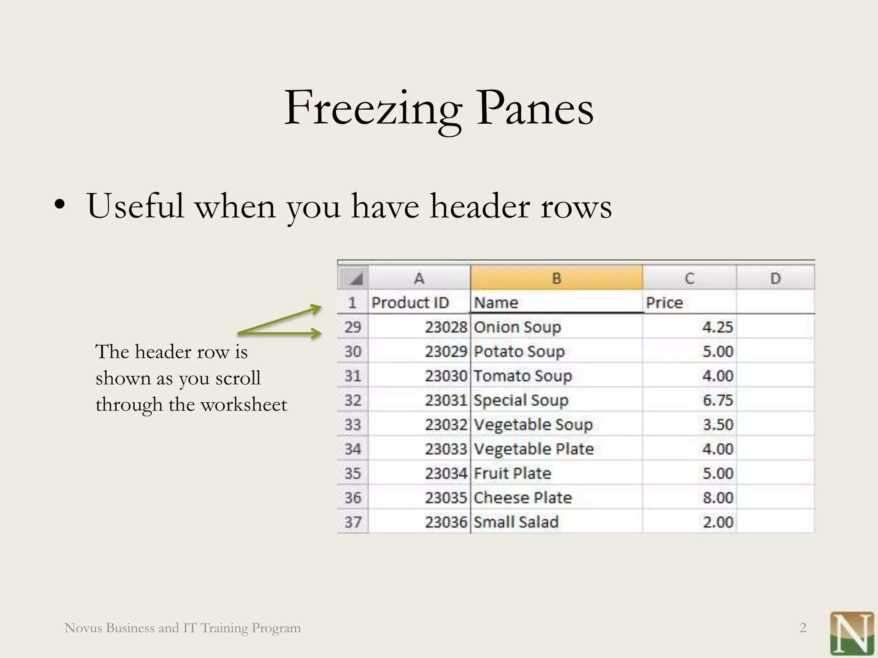
WHO ARE THE END USERS?

Slide 6
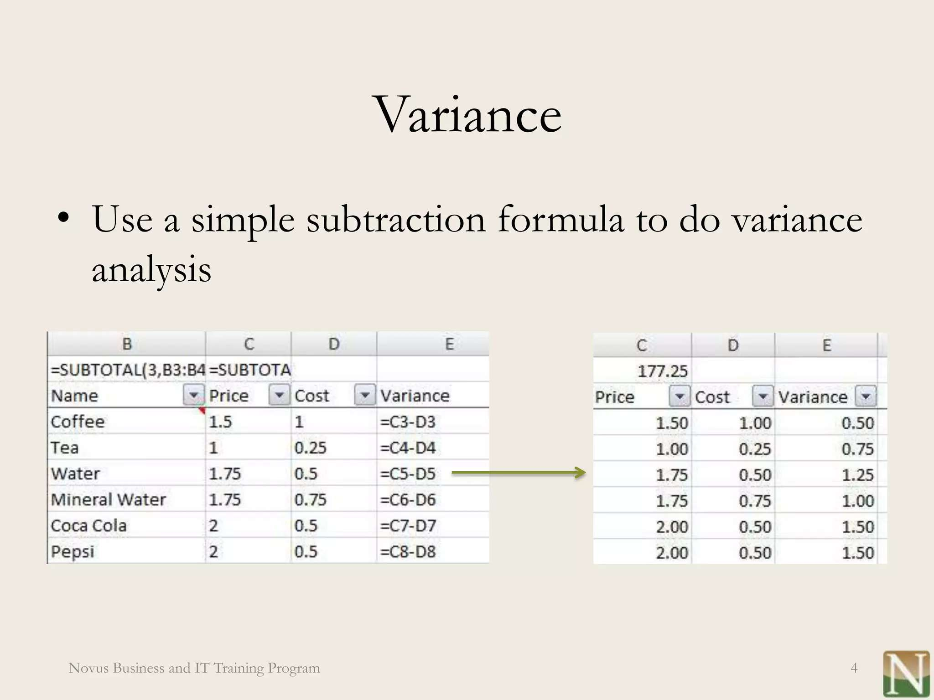

OUR SOLUTION AND ITS VALUE PROPOSITION

Slide 7
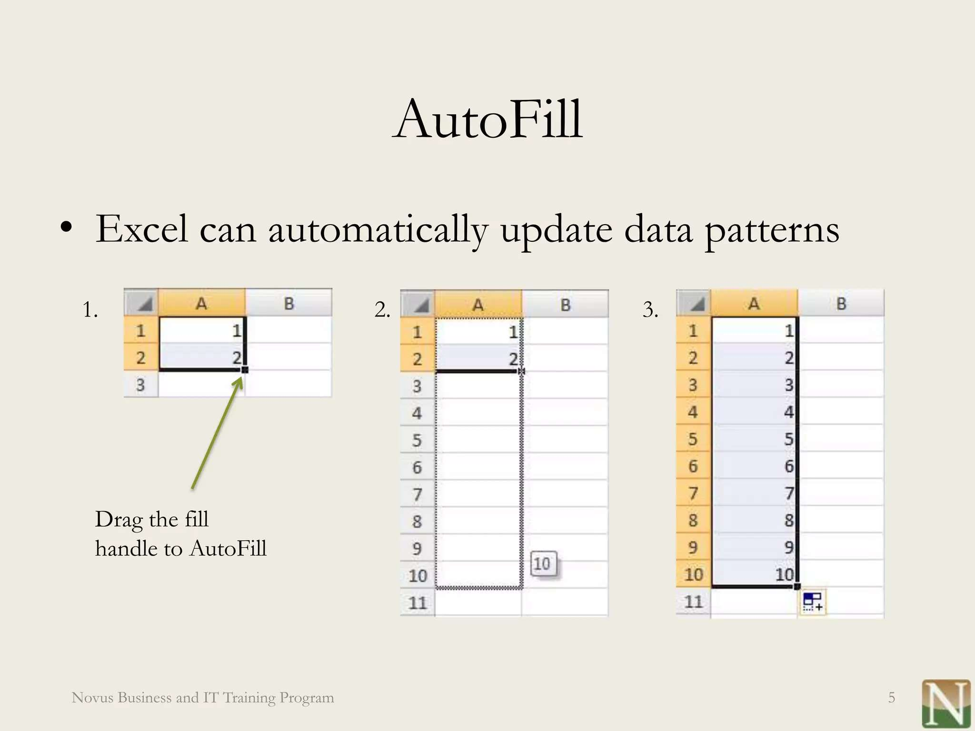
MODELLING

Slide 8
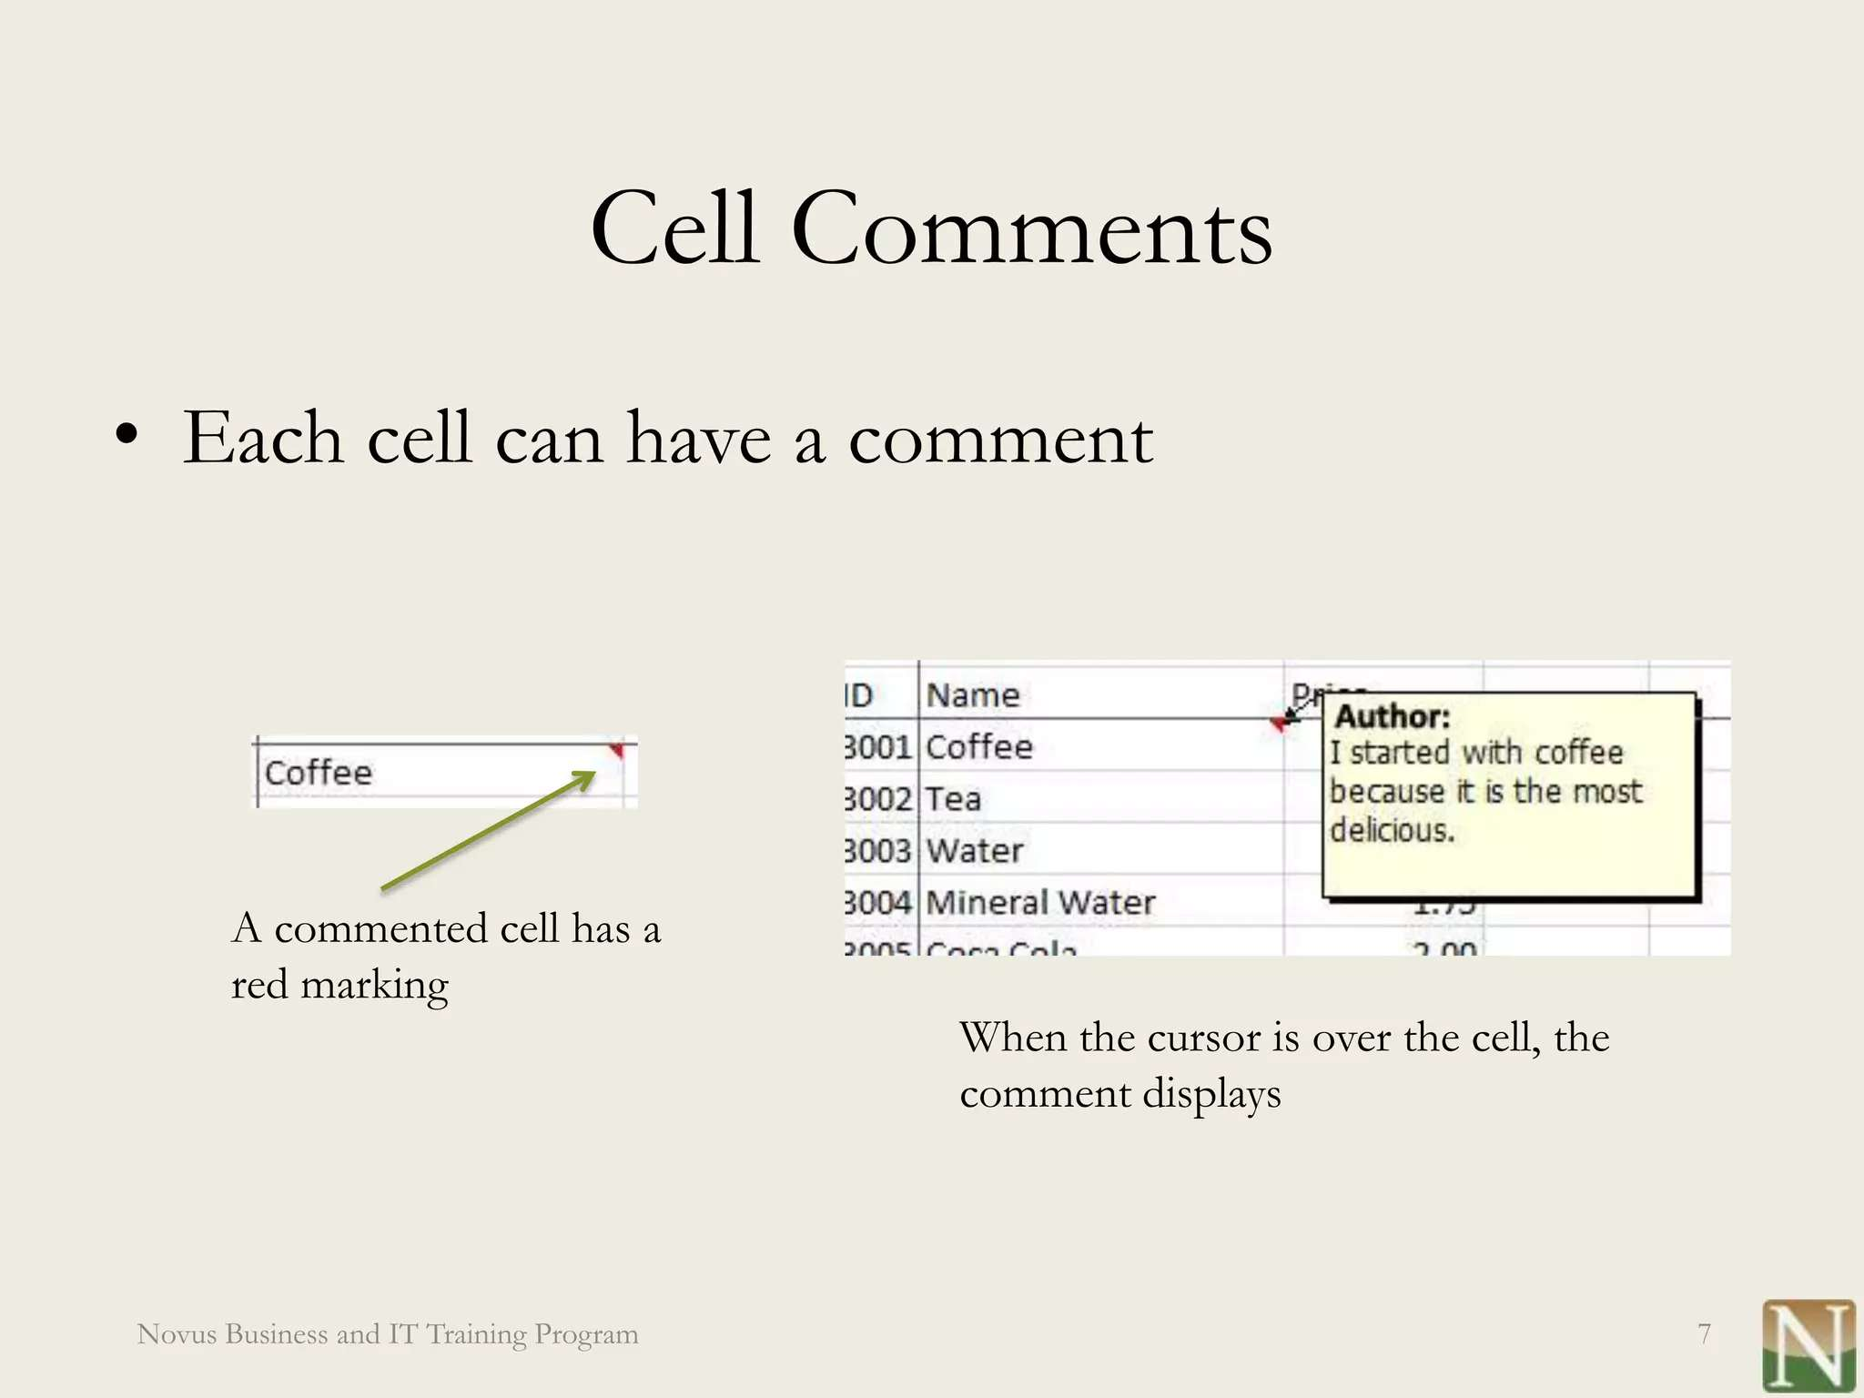

Slide 9
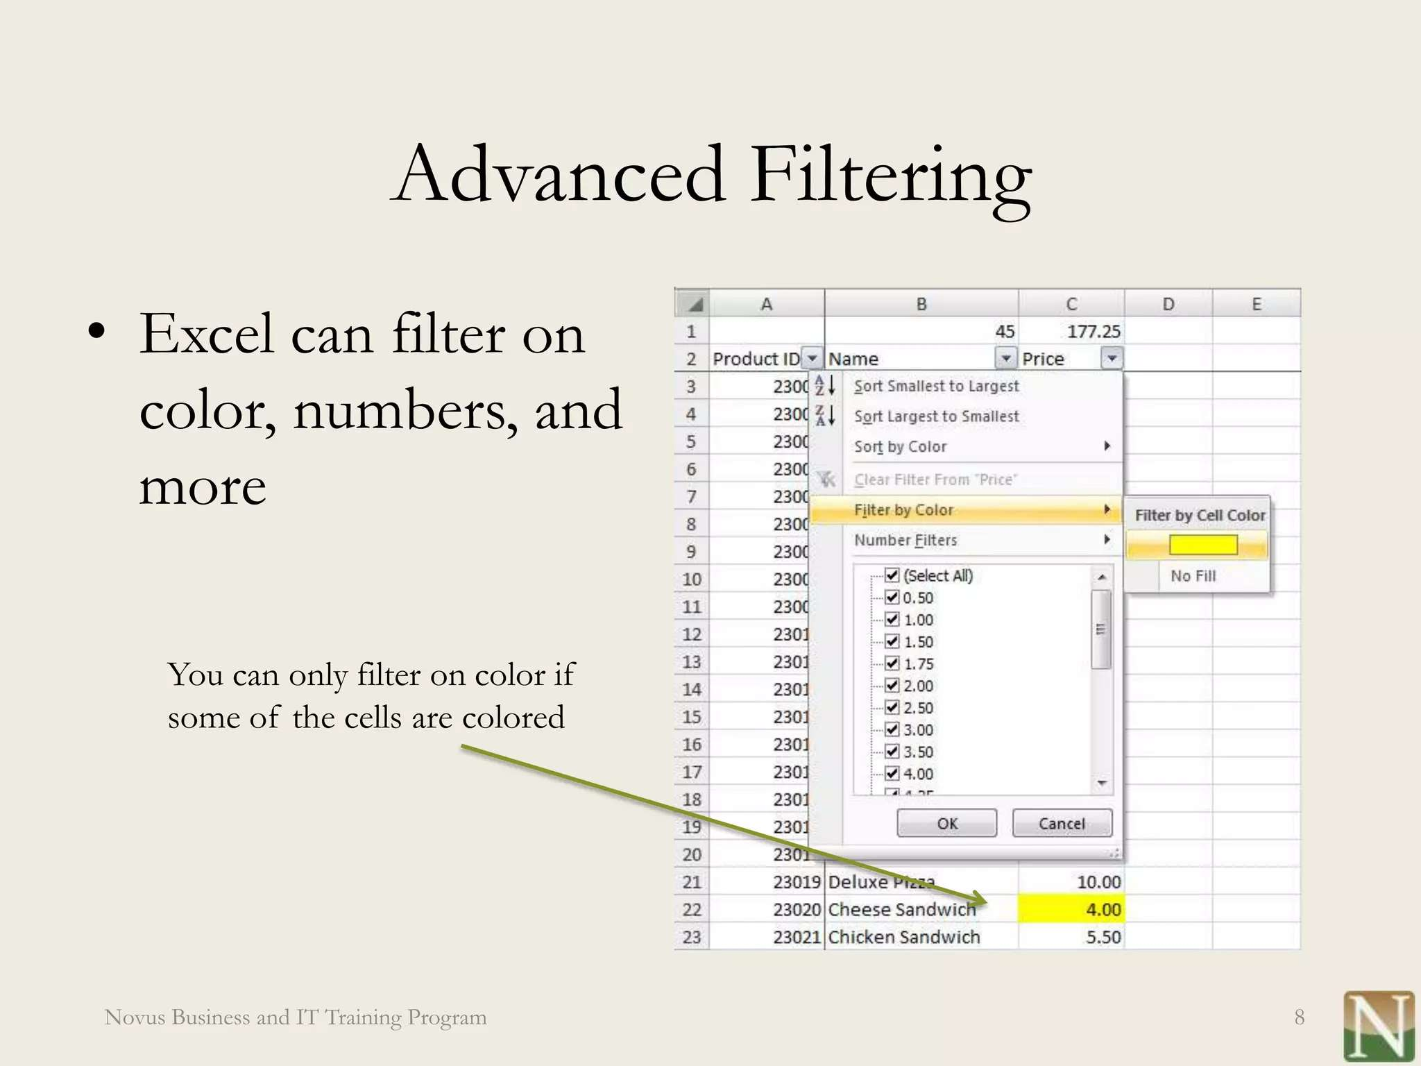

Slide 10
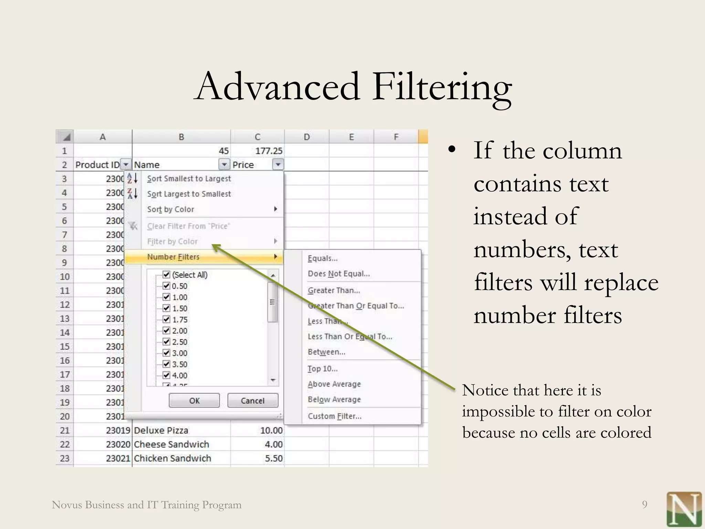
RESULTS

Slide 11
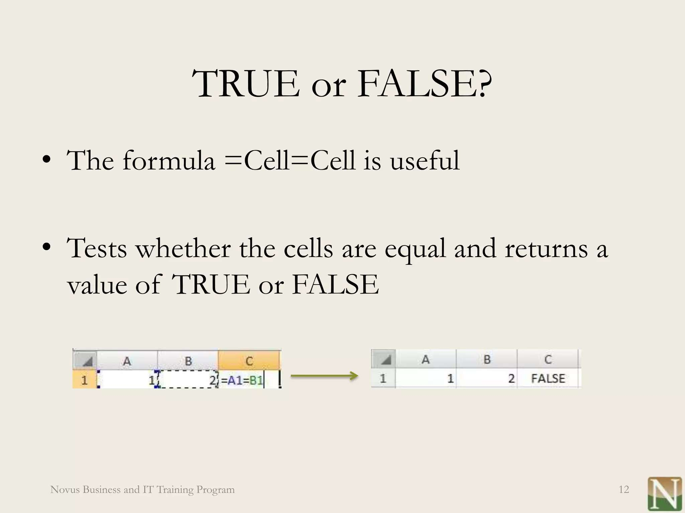

Slide 12
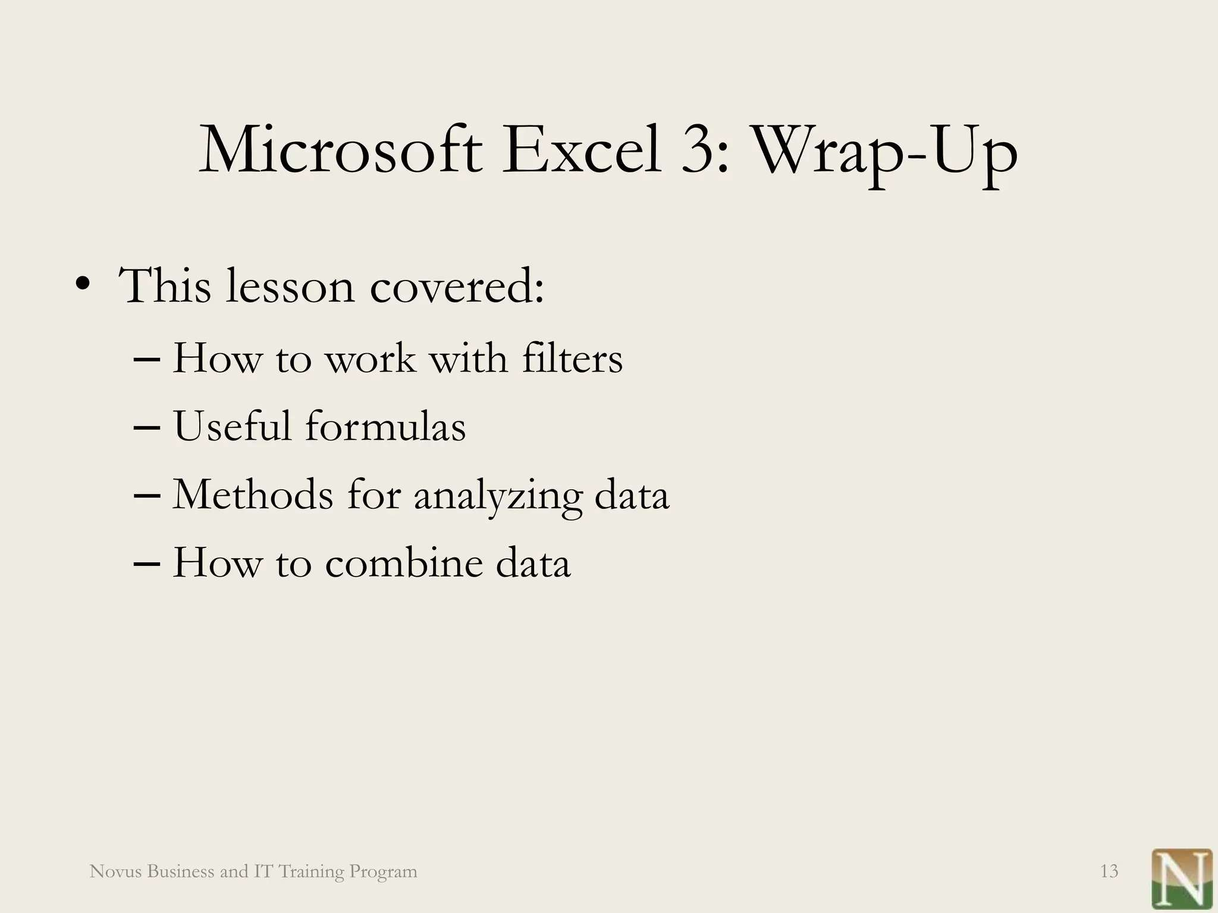
conclusion

